Slide 1
EB Digital Platform Foundational Partnerships
Mary-Lou MacDonald MSc
National Practice Lead, Health and Performance
FOR INTERNAL USE ONLY
Do not distribute

Slide 2
Notes:
For the FOUNDATIONAL partners especially:
-Canada-wide, bilingual, 24-7, partnership (potential) with US and/or global market
-evidence-based, value the science- not just the sales
-experts in their specialty
-experienced, solid track record, good reputation
-future-forward vison, stated road map in the works now
-want to work with us, to be creative and think outside the box- to be ‘pushed’- open to ‘decomposition’, values aligned but also value us
-not a race to the bottom on price- rather the balance of quality and price, but competitive pricing of course –
-quality service,
And politics!

Slide 3
Platform
Navigator
EAP
ICBT
Telemedicine
Pharmacy
Disability Management
Financial
Wellness
Mental Health
Mindfulness
Addictions
Life-Family
HR Support
Absence Management
Organizational Health Counselling
Organizational Health Consulting
Notes:
Totally unique in the marketplace
One door ecosystem in, CARE management model throughout the journey
Staged approach
Green indicates current priority areas for development (foundational partnerships), details included in this presentation

Slide 4
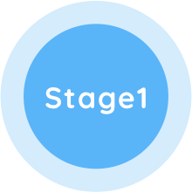
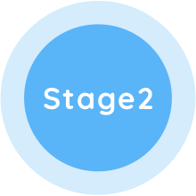
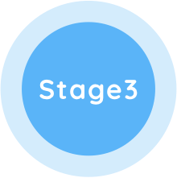
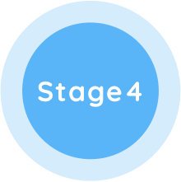
HUB- Digital Integrated Services Implementation Plan
Q1 & Q2 2020
Q3 2020
Q4 2020
Q1 2021
Virtual health care services
Care navigation / management
Care navigation to EQ network services and community providers
Virtual health care services
Care navigation / management
Care navigation services with links to HUB’s 1st group of digital health foundational partners
Virtual health care services
Care navigation / management
Care navigation services with links to HUB’s 2nd group of digital health partners & launch of additional digital health features
TPA platform with SSO to access all digital health partners
New product opportunity to capitalize on marketplace service gaps/overlaps
Notes:
-One door into ecosystem
-staged approach
-pilot early adopters
-will take time to get platform up and running so wanted to announce deals now and get them into your hands
-This schedule is ‘dynamic’ and may change as new information/challenges present
-We will communicate any changes to timeline as they arise
TPA-Third party administration
SSO-single sign on

Slide 5


Foundational Partners
EQ Care + Homewood Health + Morneau Shepell

Slide 6
Telemedicine
EQ Care
Notes:
In a recent Benefits Canada article on the top five benefits trends and issues, virtual health care was cited as the #1 trend for organizations to watch for in 2019-2020.
We also believe it to be one of the most important benefits an organization can offer its employees. With so many families having both parents working, or have no family doctor, their ability to provide employees, and their family members, with faster access to health care, without having to spend hours away from work in waiting rooms or emergency rooms, is a significant benefit to them, and to their organization.
In response we are pleased to announce our preferred provider partnership with EQ Care.

Slide 7
About EQ Care
EQ Care has been delivering exemplary healthcare services to Canadians for over 30 years.
EQ Care was the first to introduce a national and bilingual virtual medical clinic platform in Canada.
EQ Care won an award by the Federal Government for healthcare innovation. An important attribute that aligns well with HUB’s future digital health care plans.
The EQ Care virtual health care service is provided 24/7, in both official languages.
EQ Care is ISO 9001:2015 certified and complies with all privacy laws in Canada.

Slide 8


Deep Experience
12
30
300 K
YEARS
YEARS
AND MORE
Of Virtual Care
Experience
Of Health Care
in Canada
Virtual
Consultations
Through EQ Care
p
Notes:
Partner in US being announced soon

Slide 9


Certification and Awards
ISO 9001:2015 certified
Continuous Innovation Award
Ensures that EQ Care consistently provides products and services that meet customer and applicable regulatory requirements
Aims to enhance customer satisfaction through effective processes for both improvement and quality assurance of the system
Recipient of the Canada Health Infoway innovation award for eVisits
Artificial intelligence integration providing decision support for practitioners across specialties

Slide 10

Service First Approach
Canada
Wide
First
Nations
Advocate +
Case Manage
98
%
Client
Satisfaction Score
In French +
English, 24/7
Traditional medicine support
To ensure the right “next steps” in care
p

Slide 11




Virtual Care with a “Service-First” Approach
1
2
3
4
Open App
Nurse / Care Manager
Doctor
Next Steps in Care
The patient starts a visit via the web, iOs or Android app anytime 24/7
The patient is welcomed with empathy by the Nurse / Care Manager who assess symptoms and connects the patient to the medical practitioner
The patient consults the medical practitioner virtually in minutes
Nurses / Care Managers coordinate the next steps in care such as medical tests, specialist referrals, prescriptions and follow-up care

Slide 12



Key Elements of the Value Proposition for Plan Members
Doctor Availability
Quick Referrals
E-Services
Care Advocacy
Access to General Practitioners, online, to address medical issues such as:
Cold, flu, fever, sore throat
Urinary tract infection
Skin issues, rash
Stomach ache, diarrhea, vomiting
Musculoskeletal issues
Mental health
Pediatrics
Referrals to specialists such as:
Psychologists and Psychiatrists
Pediatricians
Dermatologists
Orthopedists
A wide scope of medical and allied health specialists
E-Services such as:
E-prescriptions
E-lab requisitions
Other medical test requisitions
Appointments for the “next steps” in care
Care advocacy and navigation:
Our mission is to advance the patient’s health care journey and optimize outcomes
EQ Care Never Turns A Patient Away

Slide 13




Mental Health + Disability Management
1
2
3
4
Preventative Access to
Mental Health and
Paramedical Services
through EQ Care & iCBT
Early Intervention
For STD Management
Virtual CBT (vCBT)
Virtual IME (vIME)
Faster access to care
and specialized treatment
Initial, midterm and final reports to track progress
Return To Work (RTW)
Stay At Work (SAW) focus
Elimination of travel related costs and delays for both the clinician and the evaluee
Expert availability and flexibility extended outside of normal working hours
Early evaluation
Intervention plan
Accelerated access to care
Pre-approved budget
Secure and confidential access to a national and bilingual network of mental health and paramedical specialists

Slide 14
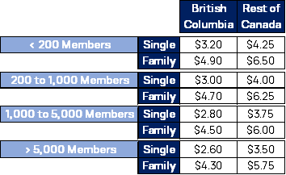
Referral Agreements: EQ Care-HUB
*Short term plans
offered to support Covid 19 immediate concern (also great opportunity if you have a client that just wants to ‘try it out’- this is the time!
$11 pmpm- single
$16 pmpm- family
The higher rates account for the shorter timeframe and spike in utilization given the rush for Coronavirus related information requests and access to service
*Optional Benefit plans (billed annually)
$30- single /$22 BC residents
$50- family/$35 BC residents
These base PMPM rates apply to new business within the business-to-business model.
Volume discounts also apply:
Total number of HUB members HUB Member Discount
Above 30,000 5%
Above 150,000 8%
*If the threshold is met mid-billing cycle, this new rate will take into effect in the next billing cycle.
*Includes 10% commission and HUB admin fee
Notes:
Based on the aggregate amount of members that have signed up through HUB, a volume discount will be applied across the rates in the table above for HUB clients. If the threshold is met mid-billing cycle, this new rate will take into effect in the next billing cycle.
Volume Discount
Total number of HUB members HUB Member Discount
Above 30,000 5%
Above 150,000 8%

Slide 15
Free EQ Care Telemedicine Trial
For all HUB Advisors, licensed service teams and families- for 3 months
EQ will need to know the following:
Full name
Unique identifier (employee number)
Single or family plan
Province
If you are interested, please send your information (noted above) to marylou.macdonald@hubinternational.com.
*We will be looking for your feedback on the service at some point as well.
Notes:
Based on the aggregate amount of members that have signed up through HUB, a volume discount will be applied across the rates in the table above for HUB clients. If the threshold is met mid-billing cycle, this new rate will take into effect in the next billing cycle.
Volume Discount
Total number of HUB members HUB Member Discount
Above 30,000 5%
Above 150,000 8%

Slide 16
Mental Health
Homewood Health- EFAP

Slide 17



Slide 18
Why Partner With Homewood?

Slide 19
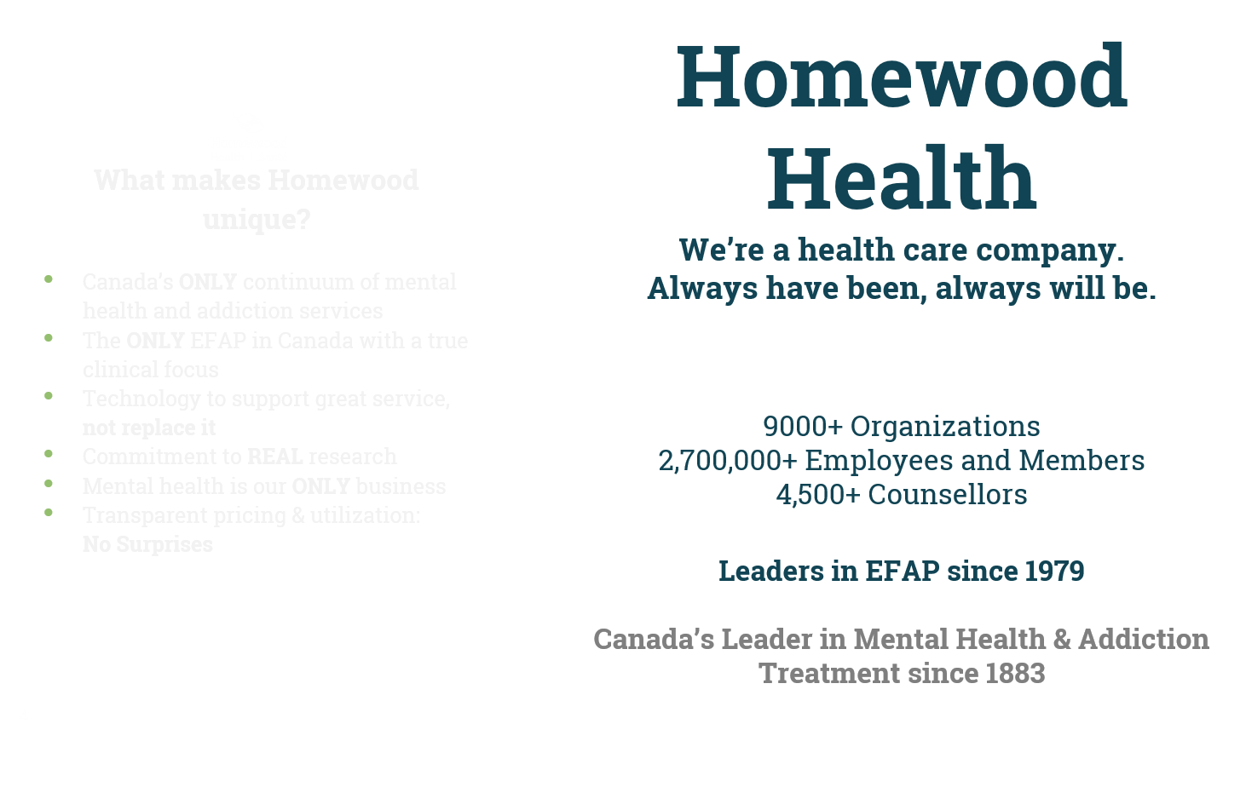

Slide 20
HUB Plans
Digital E@P
Meets the needs of today’s employee
Low Cost, High Perceived Value
$.58 pmpm
$6.96 per year
Classic EAP
Everything you need /competitive price
RFP Friendly
$2.53 pmpm
$30.36 per year
HUB Enrich
For employers who want a more robust mental health program:
Prevention-focused/Higher Touch
$7.23 pmpm
$86.76 per year
*includes commission
*based on 8% pooled utilization
*includes commission
*based on 8% pooled utilization
*includes commission
*based on 12% pooled utilization
Notes:
10% commission and HUB admin fee, based on 8% pooled utilization
.50 net
$6.00 net per year
$2.20 net
$26.40 net per year
10% commission, based on 12% pooled utilization
$6.25 net
$75. net per year

Slide 21

e@p
The Virtual EAP

Slide 22

Features and Benefits
Investment Level $$$$
Value Propositions:
Focused on providing a range of services and access points that are familiar and comfortable to digital users
No unnecessary bells and whistles
Cost effective, budget conscious
Based on 8% annualized pooled utilization
Digitally-based & Self Directed
i-Volve Online CBT
Homewood’s mobile app
Homeweb.ca
Crisis line and referral to community support for urgent needs
Fully digital collateral
Team-based, telephonic account support
$ .58 pmpm

Slide 23
Optional Add-ins e@p PLUS
Access to counselling network using paramedical benefits. Allows client to find good quality counselling at lower than market rates with receipt for reimbursement through psychological paramedical benefits
Potential to add in LifeSmart coaching services
Potential to add in online group therapy (coming soon)
Integration with virtual health providers

Slide 24
Employee Assistance Program
Our Classic Version

Slide 25
Features and Benefits
Investment Level $$$$
Value Propositions:
Meets the needs and expectations of organizations that want a traditional EAP
Provides the usual EAP program components
RFP and Proposal friendly
Based on 8% annualized, pooled utilization
Traditional Short-Term Counselling (3-4 session model)
E-counselling (chat, email)
Telephone counselling
Live face to face video counselling
i-Volve Online CBT
Homewood’s mobile app
Homeweb.ca
LifeSmart services
Account Support based on size
$2.53 pmpm

Slide 26
Optional Add-ins
Classic PLUS
Could add in depression care and trauma care to strengthen mental health components
Extend counselling beyond traditional EAP by providing access to counselling network using paramedical benefits. Allows client to extend the engagement with good quality counsellors at lower than market rates with receipt for reimbursement through psychological paramedical benefits
Integration with virtual health providers

Slide 27
HUB Enrich
The EAP that Enriches Life

Slide 28
Features and Benefits
Investment Level $$$$
Value Propositions:
Focus on prevention and support
Higher Touch
Provides something for everyone
More ‘Cadillac’ type of approach
Based on 12% annualized, pooled utilization
Heavy focus/promotion on LifeSmart Services for nutrition, fitness, wellness, resilience building
Included Depression Care and Trauma Care
Traditional Counselling Model
Telephone counselling, E-Counselling & Video Counselling
i-Volve Online CBT
Homewood’s mobile app
Homeweb.ca
Included Group Wellness interventions
Manager Mental Health Training
Org. Wellness/Org Dev consulting units (No. TBD)
Strategic Account Management
$7.23 pmpm

Slide 29
Optional Add-ins
Enrich PLUS
Depending on size of block or organization, can add in additional monthly premium for treatment
Could look to tailor specific HUB experience components – ie dedicated phone line with priority answering
Add certification component to the manager mental health training and run HUB customer cohorts with tailored content and customized course materials and modules
Integration with virtual health providers

Slide 30
Continuing to Evolve, Continuing to Lead
Coming Soon

Slide 31

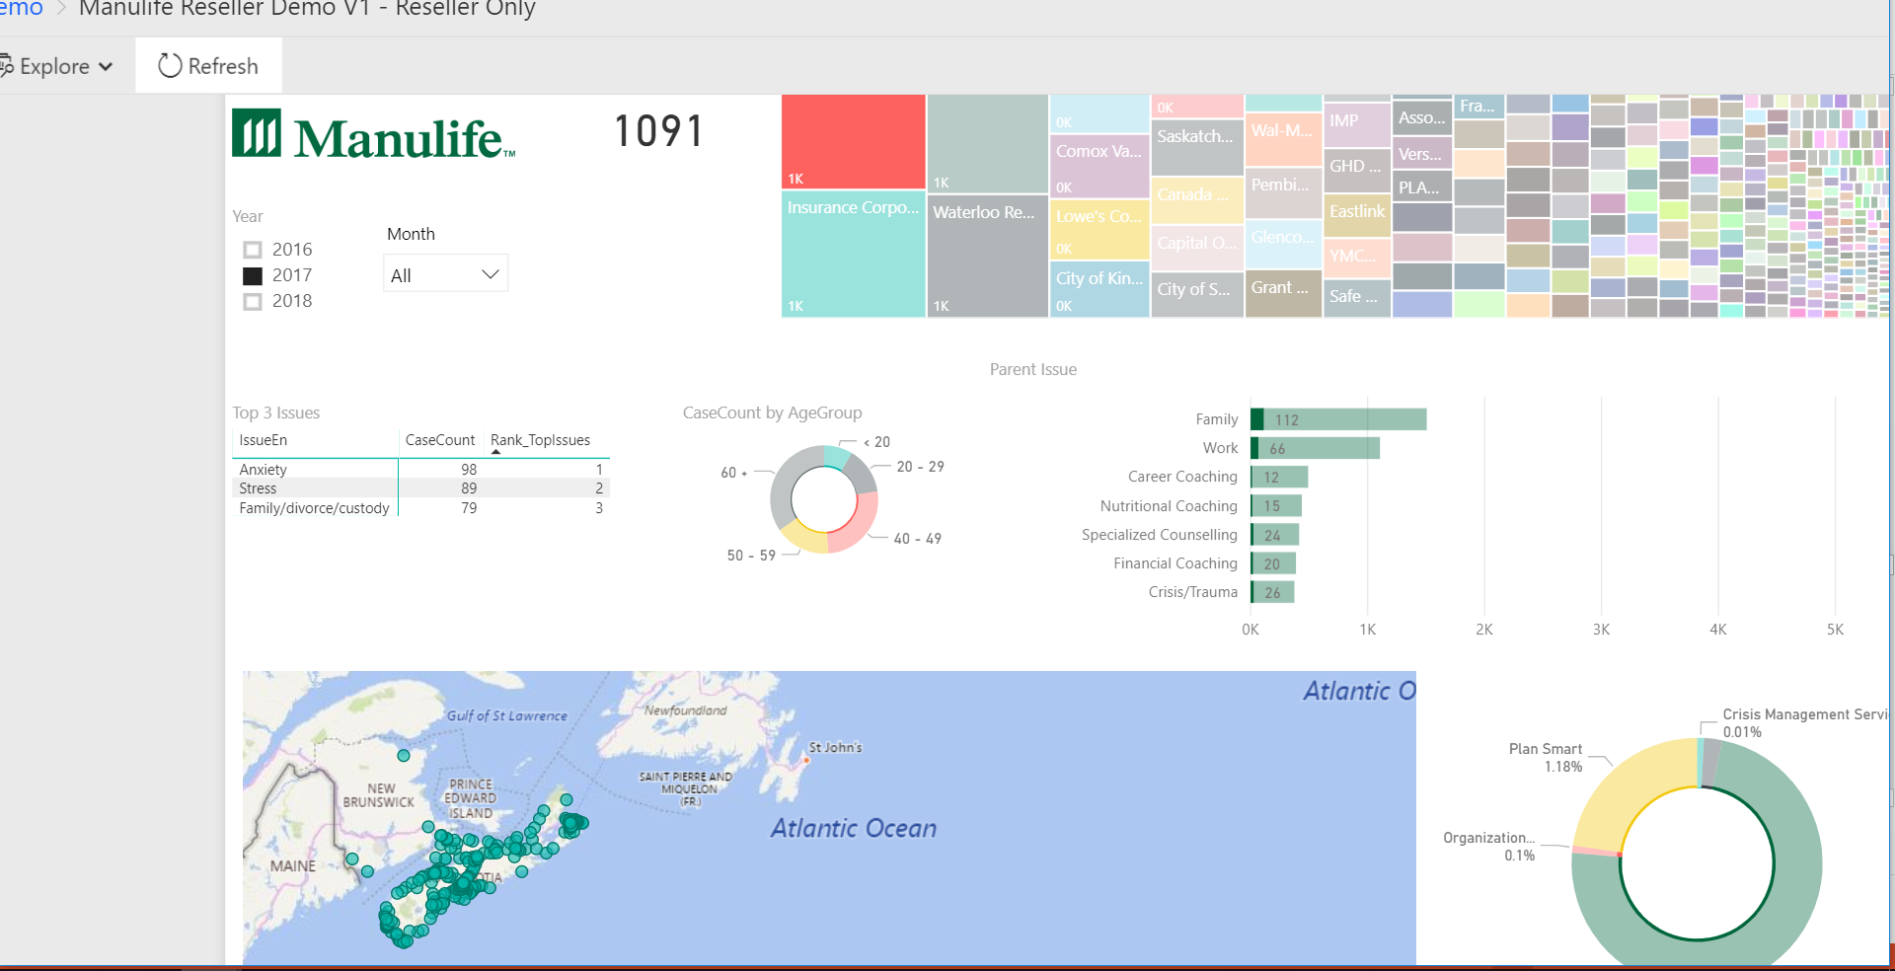
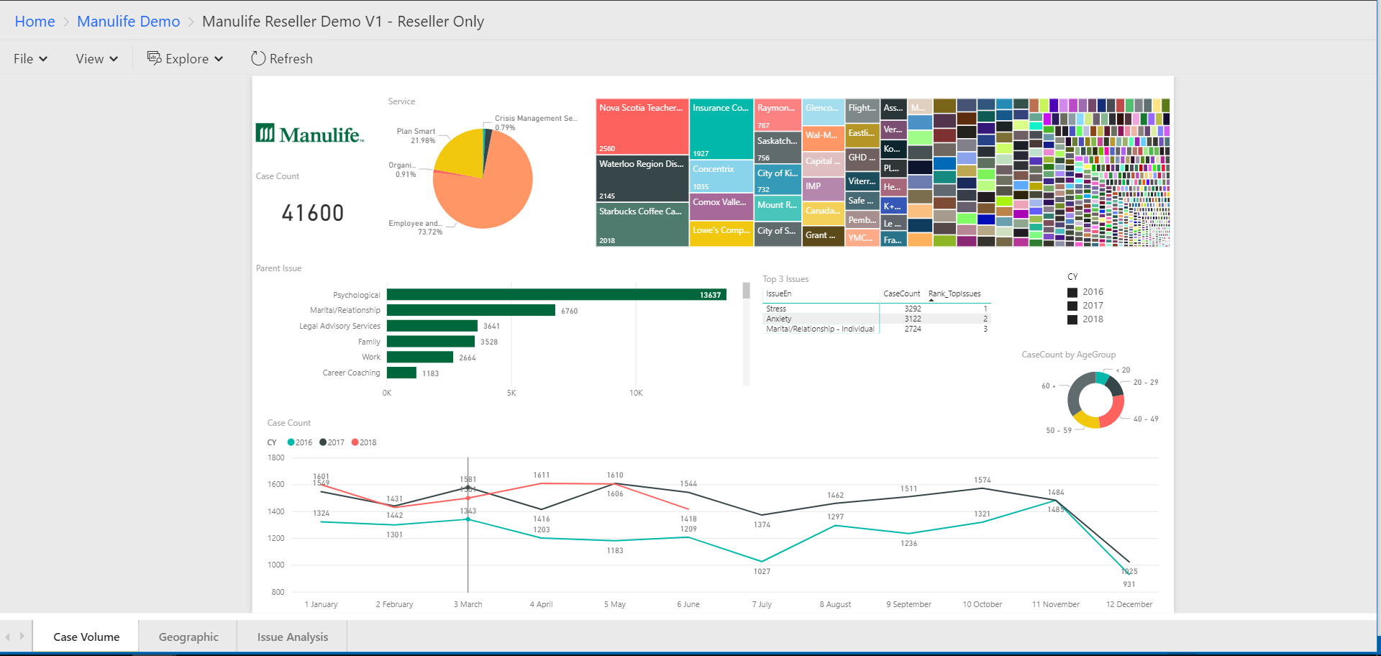
Meaningful Insights Powered by Microsoft Power BI
Tailored dashboard
Real-time data visualization
Trending, change over time, historical data
Sort, slice and dice global data geographically
By case type and presenting issue
Tailor your dashboard for easy, real-time access to data
Work with your Homewood Account Executive to turn data into action

Slide 32

New for 2020
Homewood’s ‘Doc Talk’ Podcast Series
Podcast series featuring relevant, interesting interviews with Homewood’s clinical and medical professionals including:
              Psychiatrists
            Addiction Medicine Physicians
            Family Physicians
            Psychologists

Slide 33

New for 2020
Homewood’s Guided Pathways
Assessment
Resources
An online experience designed to help employees identify the best and appropriate Homewood resources to help manage the condition or issue they are facing:
    Stress
Depression
Anxiety
Others
Homework
Coaching

Slide 34
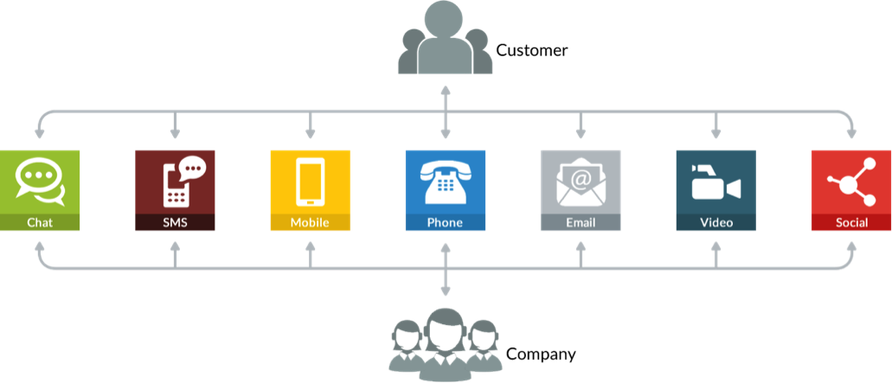
Omni-Channel Contact Centre: Meeting People Where They’re At
New for 2020
Allows callers to access Homewood’s client services centres using the method of their choice:
    Text Messaging
    Live Chat Messaging
    Phone Calls
    Email
    Social

Slide 35
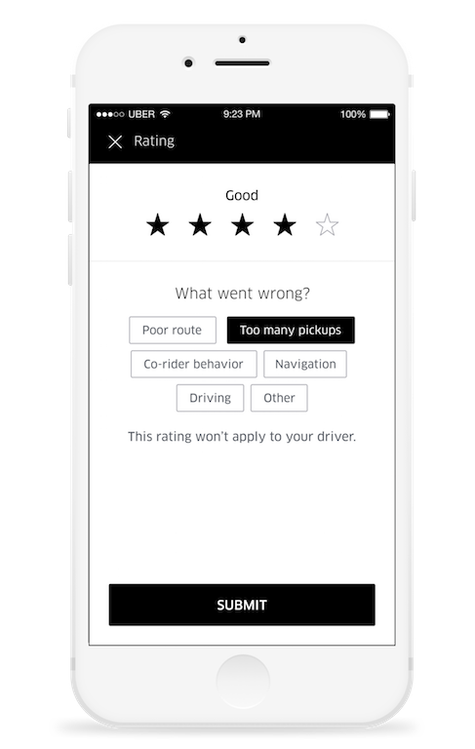

Micro-Feedback = Macro-Value
Coming
Up
Presents the client with the opportunity to provide feedback at multiple points during their case
After the intake
After a counselling session
After a web experience
At the end of the case

Slide 36

Online Case Initiation
Coming
Up
Allows clients to fully initiate a new case from their desktop or device
    Book first and follow up sessions
    Text-based reminders and follow ups

Slide 37
Mental Health
Morneau Shepell- iCBT

Slide 38
Overview of partnership services
AbilitiCBT
Total Well-being Index (TWI)

Slide 39

AbilitiCBT

Slide 40
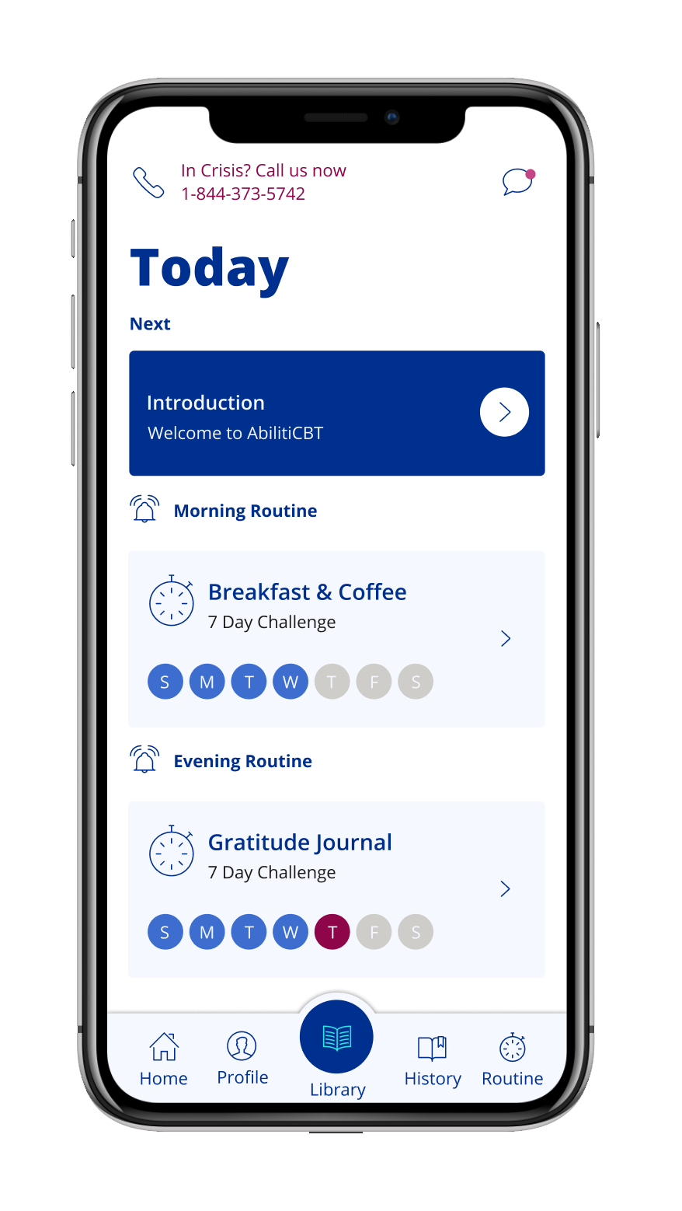
Key features
AbilitiCBT is a therapist-assisted Cognitive Behavioural Therapy program offered through a robust online platform.
But, it’s more than a cool platform with a consumer-grade user experience.
AbilitiCBT uses digital education, videos and assignments with continuous review and oversight by a therapist to help users meet their goals.
Experts agree that results of iCBT and face to face are not significantly different; supervised iCBT (like AbilitiCBT) is preferred to assure adherence and promote exposure.
Programs for anxiety, depression, sleep, pain
and return to work
Dedicated therapist for guided care
Access to 24/7/365 crisis intervention
$2.99 pmpm
Notes:
Includes 10% commission and HUB Admin fee
More than a platform
Initial online screening
Initial telephonic or video consult with dedicated therapist
4 core programs for anxiety, depression, sleep and pain
10 modules that include:
Ongoing online assessments
Multimedia learning
Skill-building exercises, activities and tracking
Continuous review and oversight by therapist
Telephonic, chat or video check-ins with therapist
Access to 24/7 crisis support line staffed by Masters’ level clinicians
Dedicated therapist
Guides each program and ensures ongoing suitability of AbilitiCBT
Initial telephonic or video consult on every case
Ongoing communication with client as per needs of each case
Experts agree:
“Across all 3 reviews, there is support for iCBT as appearing to result in outcomes that may be equivalent to face-to-face care.” Janine V. Olthuis, PhD, Assistant Professor University of New Brunswick
“The answer to the question “How effective is guided iCBT?” is: “Just about as effective as face-to-face”. Gerhard Andersson PhD, professor, Linköping University, Linköping, Sweden
“Results of iCBT and face to face are not significantly different. Supervised iCBT seems preferred to assure adherence and promote exposure.” Miel Vugts, University of Tilburg, The Netherlands

Slide 41
AbilitiCBT can drive better mental health outcomes across workforce segments
Typical distribution of workforce (source: MSI TWI)
1. As a prevention and early intervention tool: combined with increased awareness, prevention and early intervention are key to ensuring the majority of the workforce remains low risk
Low risk (optimal)
2. As a key part of more complex support provided to strained and high risk segments to reduce the risk/duration of mental health-related absences and associated costs
Strained
High Risk

Slide 42
Wellness + Organizational Health
Morneau Shepell

Slide 43
Total Well-being Index

Slide 44
Total Wellbeing Index (TWI)
Bronze
Silver
Gold
TWI
Personalization
Newsfeed
Challenges
Wearable integration
Base reporting
LIFT automated journeys
Incentives
Tiers/points
Additional wellness – roadmap
Additional LIFT challenges – roadmap
Coaching
TWI analytics
LIFT Global Challenge – roadmap
Custom activities – roadmap
Biometrics integration – roadmap
Spouse rewards tiers/points – roadmap
Everything in Silver, plus:
Everything in Bronze, plus:
$1.15 pmpm
$2.88 pmpm
$2.01pmpm
Notes:
Includes 10% commission and HUB Admin fee

Slide 45
Questions?
marylou.macdonald@hubinternational.com
Mobile: 289.231.1450
Direct: 613.228.1504

